Slide 1
Objectives
Define and Evaluate your Assets
Define Data Flow over your DFD
Define Trust Boundaries
Define applications user roles and trust levels
Define Application Entry points
Define all possible threats
Define the Impact and Probability for each threat
Determine countermeasures and mitigation

Slide 2
Level 1: Diagram (Decompose the application)
Step 1: Identify Entry points
Where data enters the system (i.e. input fields, methods)
Ports, Pages, Components, APIs, Stored Procedures etc
Step 2: Identify Exit points
Where it leaves the system (i.e. dynamic output, methods)
Pages that display data, functions sending out values
Step 3: Identify Assets
Items or areas that the attacker would be interested in.
Assets can be both physical assets and abstract assets.
Step 4: Identify Trust level
Identifying trust levels that represent the access rights that the application will grant to external entities.

Slide 3
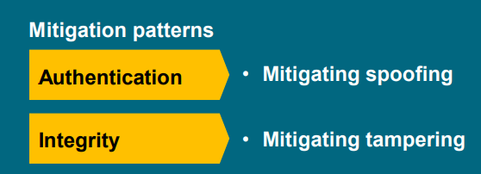
Level 2: Identify Threats
Step 1: Identify Threats
Based on diagrams
Threat categorization such as STRIDE or Application Security Frame (ASF) can be used
Use Attack Trees
Create the threat list
Apply the relevant parts of STRIDE to each item on the diagram
Step 2: Addressing each threat
Ex:
Step 3: Identify Vulnerabilities
Step 4: Rank the Threats
Risk ranking (security risk for each threat)
Two methods for ranking
1. Probability * Impact Ranking 2. DREAD Average Ranking

Slide 4
Level 3: Countermeasures & Mitigation
Step 1: Mitigation Patterns
Apply appropriate secure design strategies
Leverage proven best practices
Reuse organization security services, e.g., – Single-Sign-On, Log Server
Do not reinvent the wheel

Slide 5
Outputs
Assets
Threats
Vulnerabilities
Threat agents

